Slide 1
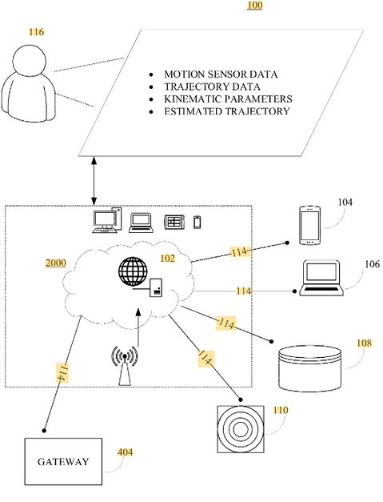
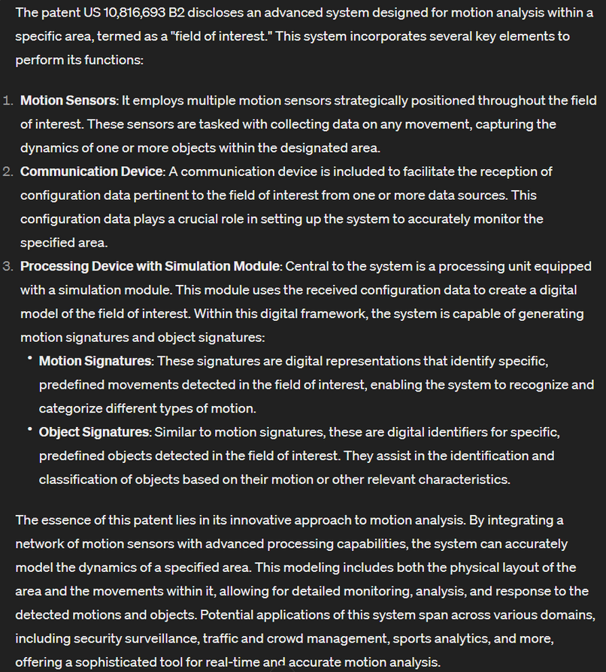
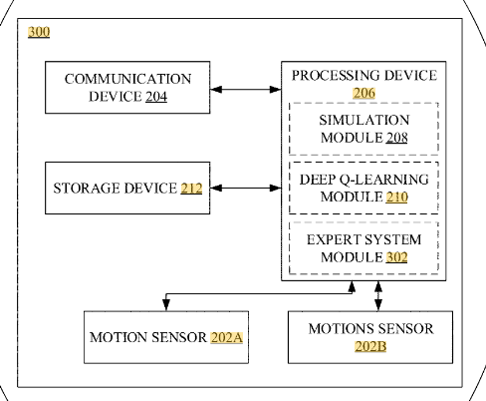
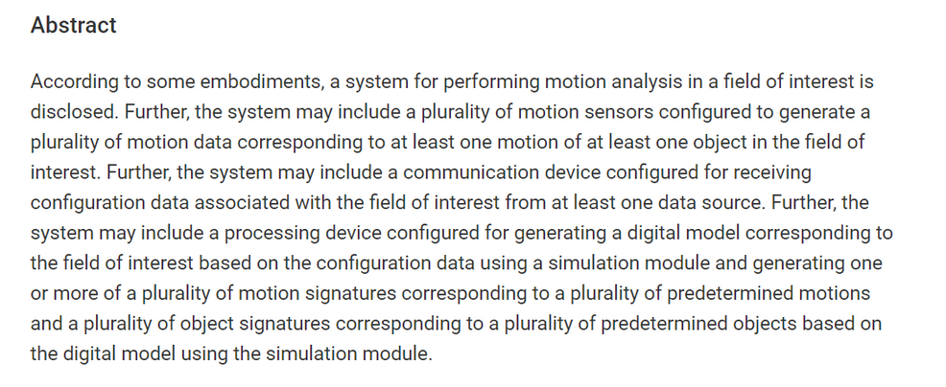
Motion analysis
https://patents.google.com/patent/US10816693B2/en

Slide 2
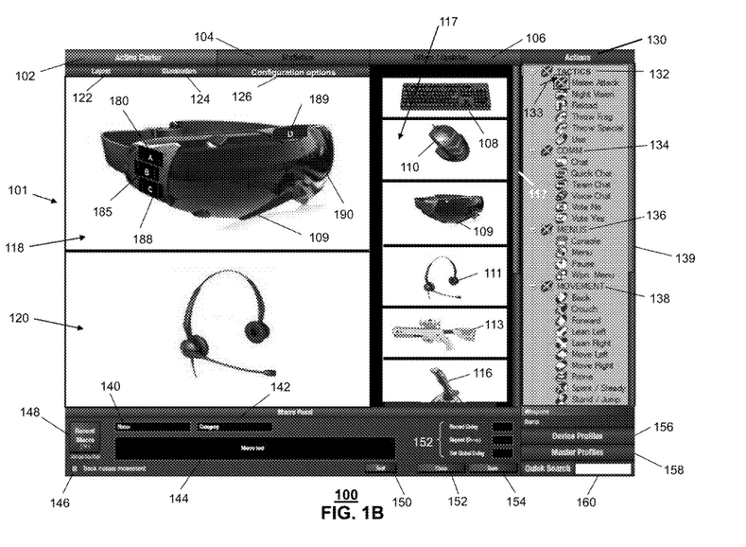
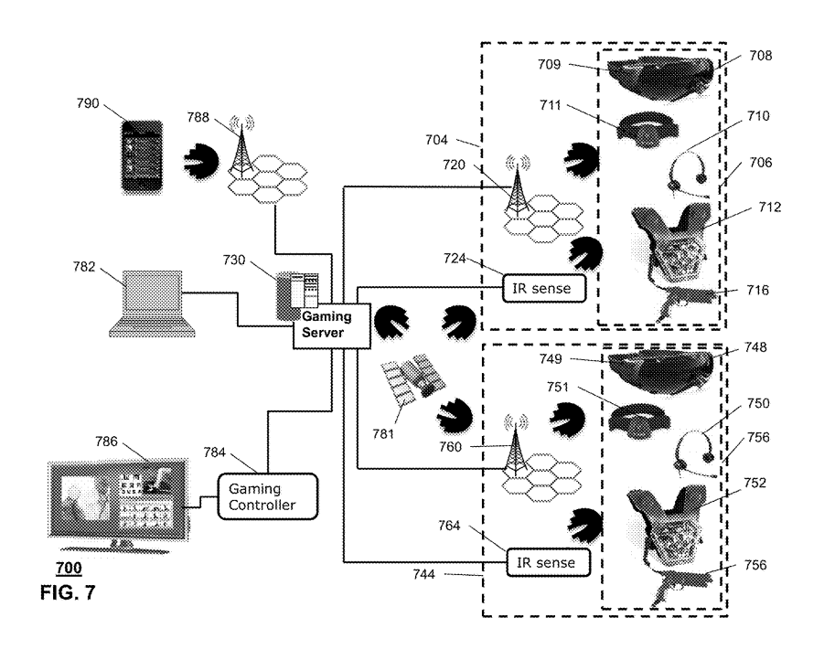
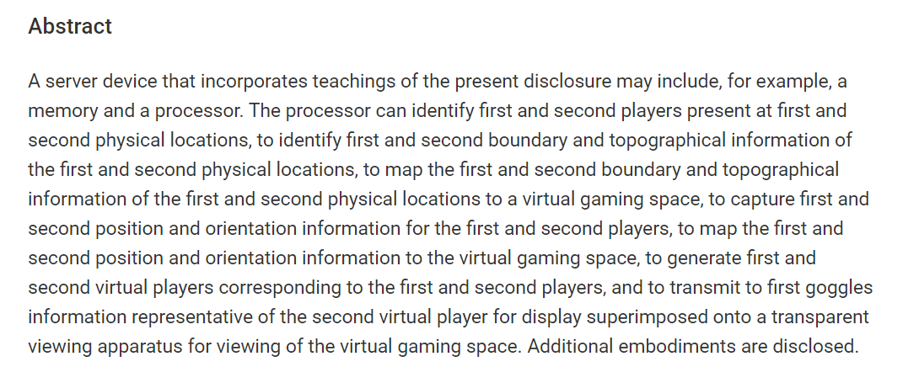
Apparatus for adapting virtual gaming with real world information
https://patents.google.com/patent/US20210268385A1/en?oq=%2320210268385

Slide 3
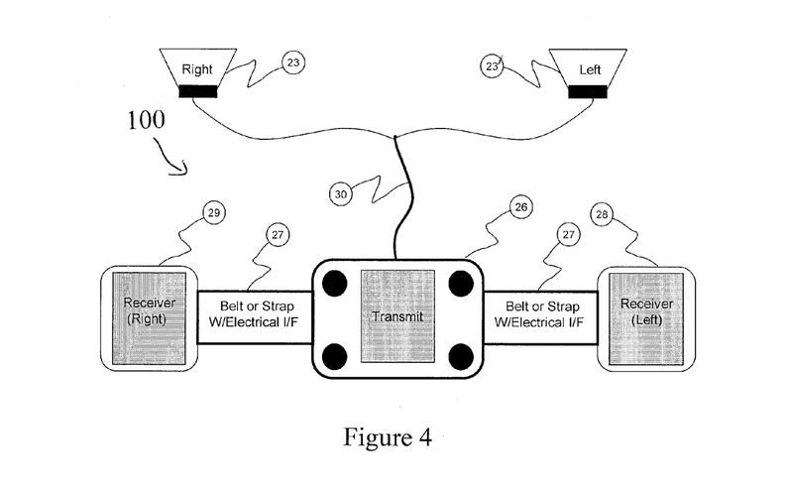
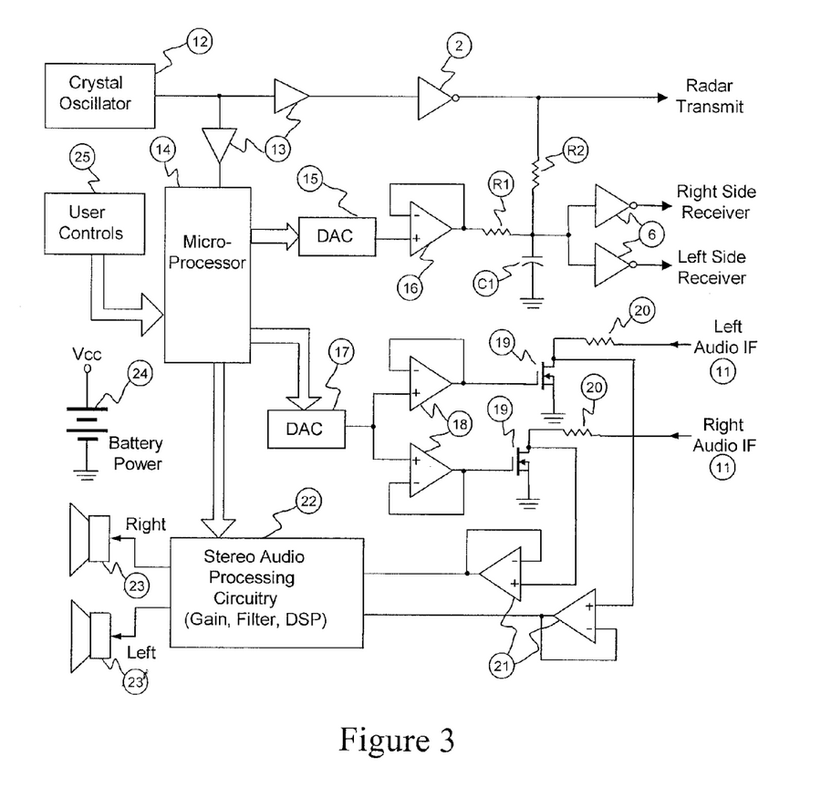
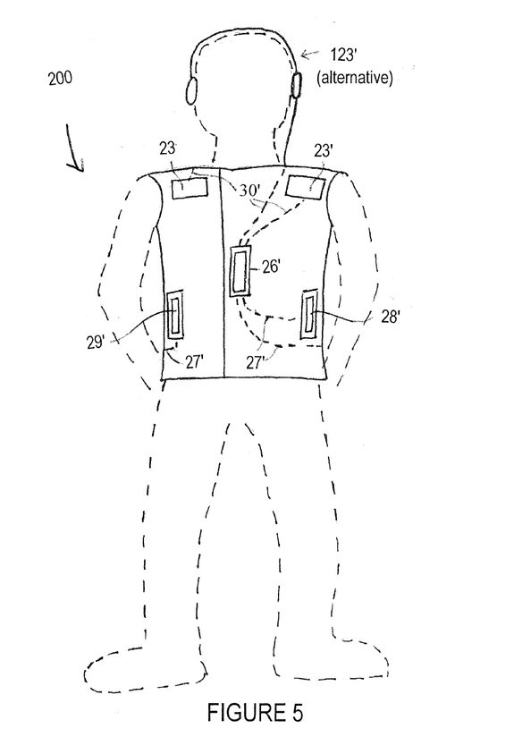
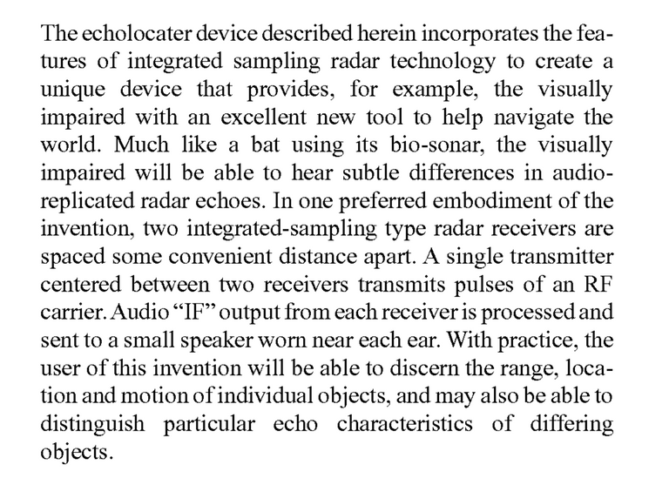
Radar echolocater with audio output
https://patents.google.com/patent/US20130050009A1/en?oq=%2320130050009

Slide 4
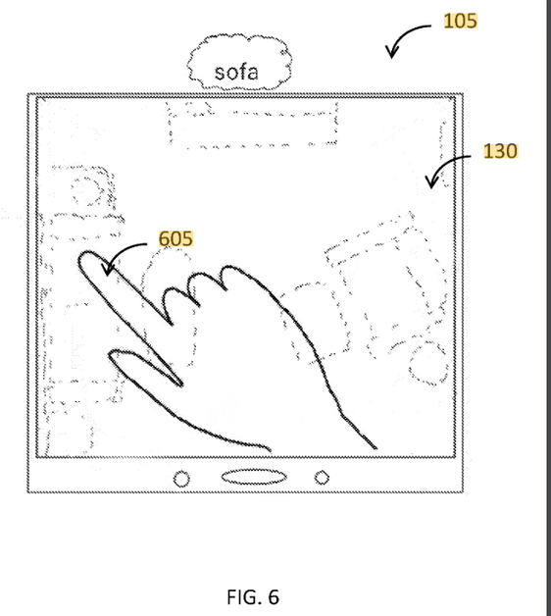
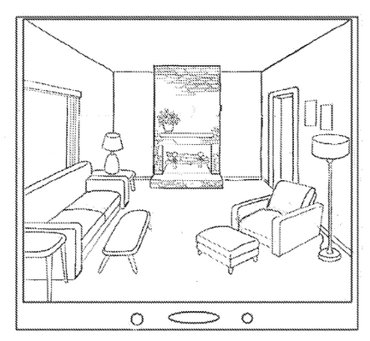
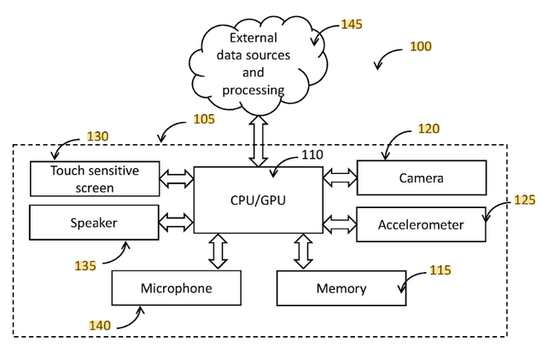
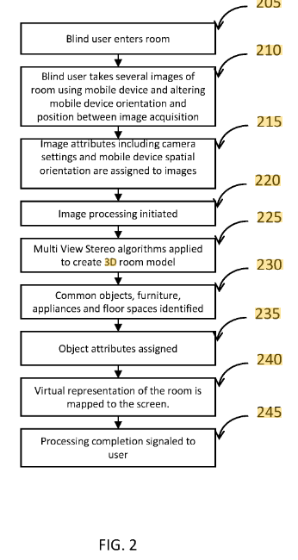
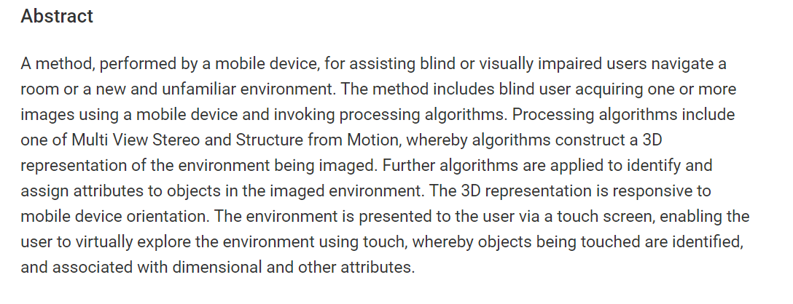
Systems and methods for impaired person environment navigation assist
https://patents.google.com/patent/US10816693B2/en?q=(echolocation+simulater)&oq=echolocation+simulater

Slide 5
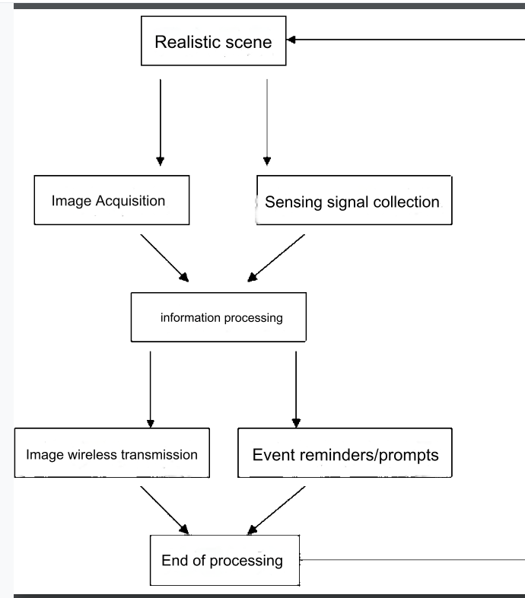
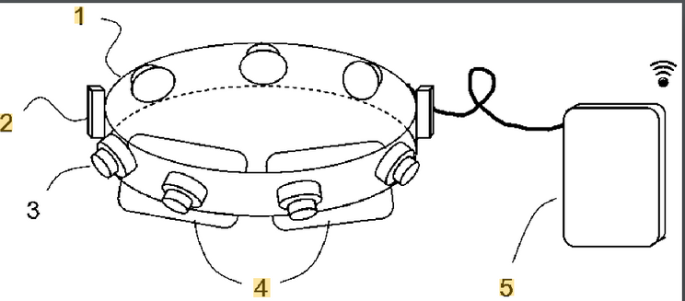
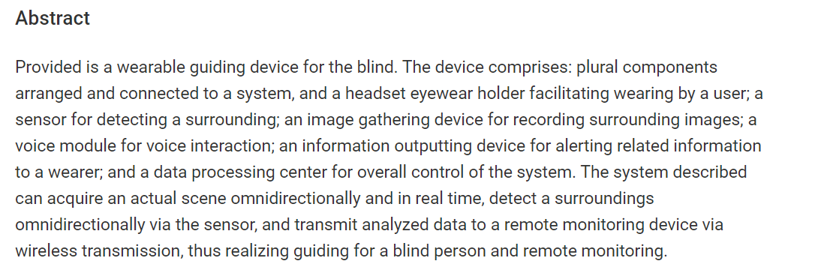
XWearable guiding device for the blind
https://patents.google.com/patent/WO2016086440A1/en
image gathering

Slide 6
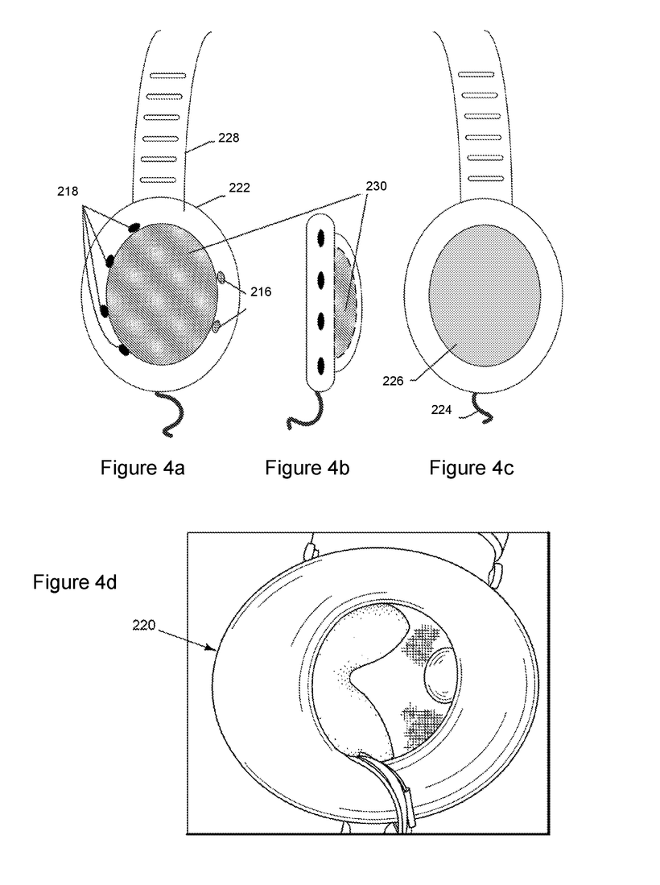
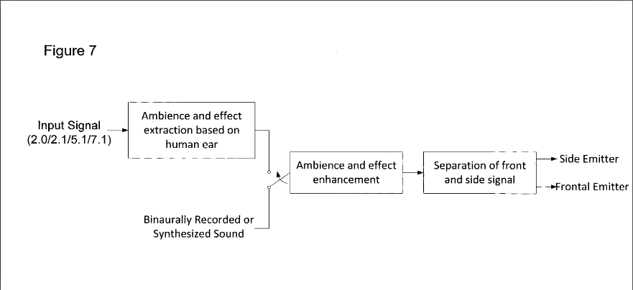

Listening device and accompanying signal processing method
https://patents.google.com/patent/US9357282B2/en?q=(3D+sound)&oq=3D+sound

